Slide 1
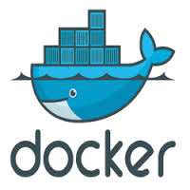
DOCKER

Slide 2
Docker - Introduction
Docker is an open platform that enables developing, shipping, and running applications.
Docker provides the ability to package and run an application in a loosely isolated environment called a container.

Slide 3
Docker - Introduction
Containers are the virtualizied entities provided by the OS which can provide different virtual environment for the applications.
All containers share the same kernel of the host operating system.
However these containers provide user space isolation.

Slide 4
Containers
Container 1
Container 2
Container 3
Operating System Kernel

Slide 5
Docker - Introduction
Docker works as a front end tool and makes it easy to create, delete and manage containers.
A container image is a lightweight, stand-alone, executable package of a piece of software that includes everything needed to run it: code, runtime, system tools, system libraries, settings.

Slide 6


Without Containers
App 1
App 2
I Want python 2.7
Here Python 3
Python 3
Here Python 3
Give me Python
Python 2.7
Give me Python
Operating System Kernel

Slide 7
With Containers
Container 1
Container 2
Container 3
Container 4
App 1
App 2
App 3
App 4
Python 2.7
Python 3
JAVA SE 10
JAVA SE 12
Libraries
Libraries
Libraries
Libraries
Operating System Kernel

Slide 8
Docker - Introduction
Unlike VMs, containers do not bundle a full operating system - only libraries and settings required to make the software work are needed.
This makes for efficient, lightweight, self-contained systems and guarantees that software will always run the same, regardless of where it’s deployed.

Slide 9
Containers Vs Virtual Mchines
Type I
Vitualization
Type II
Vitualization
Containers
App 1
App 2
App 1
App 2
Runtime
Runtime
Runtime
Runtime
Libraries
Libraries
Libraries
Libraries
OS
OS
Hypervisor
Operating System
Hypervisor
Operating System
Hardware
Hardware
Hardware

Slide 10
You can create, run, stop, move, or delete a container using the Docker API or CLI.
You can connect a container to one or more networks, attach storage to it, or even create a new image based on its current state.
By default, a container is relatively well isolated from other containers and its host machine.
You can control how isolated a container’s network, storage, or other underlying subsystems are from other containers or from the host machine.

Slide 11
Docker - Introduction
They start instantly and use less compute and RAM.
Images are constructed from filesystem layers and share common files.
This minimizes disk usage and image downloads are much faster.
Docker containers are based on open standards and run on all major Linux distributions, Microsoft Windows, and on any infrastructure including VMs, bare-metal and in the cloud.

Slide 12
Docker - Introduction
A container is defined by its image as well as any configuration options you provide to it when you create or run it.
When a container stops, any changes to its state that are not stored in persistent storage disappears.
However any change which is stored in the container persistent storage is maintained even if the container is stopped.
However if that container is deleted, everything is lost and the image from which the container was created remains unchanged always.

Slide 13
Docker Editions
Docker is available in 2 editions

Slide 14
Docker Editions
Docker Community Edition (CE) is ideal for developers and small teams looking to get started with Docker and experimenting with container-based apps.
Docker CE has three types of update channels, stable, test, and nightly:
Stable gives you latest releases for general availability.
Test gives pre-releases that are ready for testing before general availability.
Nightly gives you latest builds of work in progress for the next major release.

Slide 15
Releases of Docker Engine and Docker Client for general availability are versioned using dotted triples.
The components of this triple are YY.mm.<patch> where the YY.mm component is referred to as the year-month release.

Slide 16
Docker-ce has two release channels--- edge and stable.
The edge channel releases a new version every month.
This is good for people looking to get new features immediately.
The stable channel releases a new version quarterly.
It is easier to maintain as you need to just update the installed version with patches and bug fixes.

Slide 18
Docker Editions
Docker Enterprise is designed for enterprise development as well as IT teams who build, ship, and run business-critical applications in production and at scale.
Docker Enterprise is integrated, certified, and supported to provide enterprises with the most secure container platform in the industry.
Docker Enterprise has private image management, integrated image signing policies, and cluster management with support for Kubernetes and Swarm orchestrators.

Slide 19
Docker Editions
It allows you to implement node-based RBAC policies, image promotion policies, image mirroring, and scan your images for vulnerabilities.
It also has support with defined SLAs and extended maintenance cycles for patches for up to 24 months.
Standalone EE engines can be licensed using docker engine activate.
Offline activation of standalone EE engines can be performed by downloading the license and using the command docker engine activate --license filename.lic.

Slide 20
Docker Editions

Slide 21
Docker Editions
A new version is released every quarter.
Each release is supported for a full calender year.
Both security updates and bug fixes are released for all the supported versions.
Docker EE is available in three tiers: Basic comes with the Docker platform, support and certification, and Standard and Advanced tiers add advanced container management (Docker Datacenter) and Docker Security Scanning.

Slide 22
Docker Pricing

Slide 23
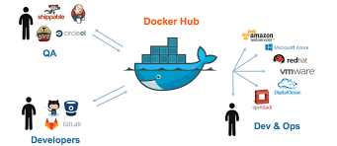
Docker Hub

Slide 24
Docker Hub
Docker Hub is the world’s largest repository of container images with an array of content sources including container community developers, open source projects and independent software vendors (ISV) building and distributing their code in containers.
Users get access to free public repositories for storing and sharing images or can choose subscription plan for private repos.

Slide 25
Docker Hub
Docker Hub supports private repositories also.
Allows finding and sharing container images with your team.
Private Repositories: Push and pull container images
Automated Builds: Automatically build container images from GitHub and Bitbucket and push them to Docker Hub
Teams & Organizations: Manage access to private repositories

Slide 26
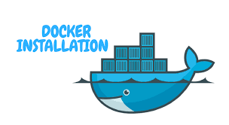

Slide 27
Docker - Installation
Docker Installation on Centos 7
sudo yum update -y
sudo wget https://download.docker.com/linux/centos/docker-ce.repo -O /etc/yum.repos.d/docker-ce.repo
sudo yum clean all
sudo yum install docker-ce docker-ce-cli -y
sudo systemctl start docker

Slide 28
Docker - Installation
Docker Installation on Centos 7
The firewalld firewall on Centos 7 by default blocks the communication between the docker containers.
To allow this communication give following commands to configure firewalld.
firewall-cmd --permanent --zone=trusted --add-interface=docker0
firewall-cmd --permanent --zone=trusted --add-port=4243/tcp

Slide 29
Docker - Installation
Docker Installation on Ubuntu
sudo apt-get update
sudo apt-get install apt-transport-https ca-certificates curl gnupg-agent software-properties-common
curl -fsSL https://download.docker.com/linux/ubuntu/gpg | sudo apt-key add -

Slide 30
Docker - Installation
Docker Installation on Ubuntu
sudo add-apt-repository "deb [arch=amd64] https://download.docker.com/linux/ubuntu $(lsb_release -cs) stable"
sudo apt-get update
sudo apt-get install docker-ce docker-ce-cli containerd.io

Slide 31
Docker - Installation
If you want the containers to communicate with each other using container names, you need to define your own network and then connect the containers to your own network.
To create your own network
docker network create your_network_name.
To check all networks created use
docker network ls

Slide 32
Docker - Installation
To check the details of your network like default network address assigned etc. use following command.
docker network ps your_network_name
To connect a container to your network use option --net your_network_name in docker run command.
docker run --name mysql --net your_network_name -d mysql

Slide 33
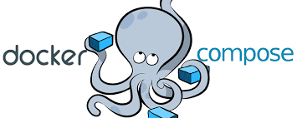
Docker Compose

Slide 34
Docker Compose
Compose is a tool for defining and running multi-container Docker applications.
With Compose, you use a YAML file to configure your application’s services.
Then, with a single command, you create and start all the services from your configuration.
Using Compose is basically a three-step process:

Slide 35
Docker Compose
Define your app’s environment with a Dockerfile so it can be reproduced anywhere.
Define the services that make up your app in docker-compose.yml so they can be run together in an isolated environment.
Run docker-compose up and Compose starts and runs your entire app.

Slide 36
Docker Compose
Compose has commands for managing the whole lifecycle of your application:
Start, stop, and rebuild services
View the status of running services
Stream the log output of running services
Run a one-off command on a service
Docker Compose relies on Docker Engine for any meaningful work, so Docker Engine should be installed.

Slide 37
Install Docker Compose
wget "https://github.com/docker/compose/releases/download/1.24.0/docker-compose-$(uname -s)-$(uname -m)" -o /usr/local/bin/docker-compose
chmod u+x /usr/local/bin/docker-compose
now check if docker-compose is running correctly by using docker-compose -v command.

Slide 38
Docker Compose
This table shows which Compose file versions support
specific Docker releases.

Slide 39
Docker Compose
Create a simple docker-compose.yml file
Add following contents to it.

Slide 40
Docker Compose
Check the syntax of the docker-compose file with the following command. The specing and indentation is important in the file.
The command will display message if there are any errors in the file.

Slide 41
Docker Compose
If there are no errorsen you can use
docker-compose up command to start the containers.

Slide 42
Docker Compose
Once docker-compose pulls all the images it will start the containers using these images and map ports as specified in the docker-compose file.

Slide 43
Docker Compose
Now open the browser on the machine and check port 8000 and 8100.

Slide 44
Docker Compose
The docker ps command will display the running containers created by docker-compose.

Slide 45
Docker Compose
You can stop all the containers with just one command ----- docker-compose down

Slide 46
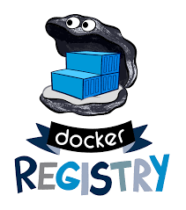
Create Internal Docker Registry

Slide 47
Internal Docker Registry
The images required for docker applications are stored in a Docker registry.
The Docker hub is the default registry for the Docker.
Thus you need to have the images stored on the Docker Hub.
Docker Hub allows you to have any number of public repositories, but allows only 1 private repository.
But for security and confidentiality reasons an organization may not want to put images on a registry that is open to internet.

Slide 48
Internal Docker Registry
For such organizations Docker allows to build their own internal repository, which can be used to store Docker images.
The internal repository also runs as a Docker container.
The internal repository can use HTTP or HTTPS.
Even though it is an internal repository, it is recommended to use HTTPS for better security.
The following steps help you build a secure HTTPS registry.

Slide 49
Internal Docker Registry
Generate a self-signed certificate that will be used to secure the internal registry.
Create a directory and create certificate within it.(All steps require root or sudo privileges)
mkdir /registry/certs
cd /registry/certs
openssl req -newkey rsa:4096 -nodes -sha256 -keyout domain.key -x509 -days 365 -out domain.crt
Be sure to use the name registrydomain.com as a CN.

Slide 50
Internal Docker Registry
mkdir -p registry/images
Now give the following command to start your internal Docker registry.
docker run -d --restart=always --name registry -v /registry/certs:/certs -e REGISTRY_HTTP_ADDR=0.0.0.0:443 -e REGISTRY_HTTP_TLS_CERTIFICATE=/certs/domain.crt -e REGISTRY_HTTP_TLS_KEY=/certs/domain.key -v /registry/images:/var/lib/registry -p 443:443 registry:2.

Slide 51
Internal Docker Registry
Test the registry.
docker pull ubuntu:16.04
docker tag ubuntu:16.04 registrydomain.com/my-ubuntu
docker push registrydomain.com/my-ubuntu
Instruct every Docker daemon to trust that certificate.
Linux OS: Copy the domain.crt file to /etc/docker/certs.d/registrydomain.com:443/domain.crt on every Docker host.
You do not need to restart Docker.

Slide 52
Internal Docker Registry
Congure basic authentication for the internal repository.
Create a directory to store htpasswd file.
mkdir /registry/auth
cd /registry/auth
yum install httpd-tools -y
htpasswd -cB htpasswd user1
Enter password for user1 at the prompt.

Slide 53
Internal Docker Registry
Congure basic authentication for the internal repository.
docker stop registry (earlier running container)
docker rm registry
Then give following command to start registry container.

Slide 54
Internal Docker Registry
Congure basic authentication for the internal repository.
docker run -d --restart=always --name registry -v /registry/certs:/certs -v /registry/auth:/auth -e “REGISTRY_AUTH=htpasswd” -e “REGISTRY_HTPASSWD_AUTH_REALM=registry-realm” -e REGISTRY_AUTH_HTPASSWD_PATH=/auth/htpasswd -e REGISTRY_HTTP_ADDR=0.0.0.0:443 -e REGISTRY_HTTP_TLS_CERTIFICATE=/certs/domain.crt -e REGISTRY_HTTP_TLS_KEY=/certs/domain.key -v /registry/images:/var/lib/registry -p 443:443 registry:2.

Slide 55
Internal Docker Registry
Congure basic authentication for the internal repository.
Now if you try to push an image to your local docker registry it will give authentication error.
Login to the registry using
docker login registrydomain.com:443
Once you provide username and password then you can push the image to the registry.

Slide 56
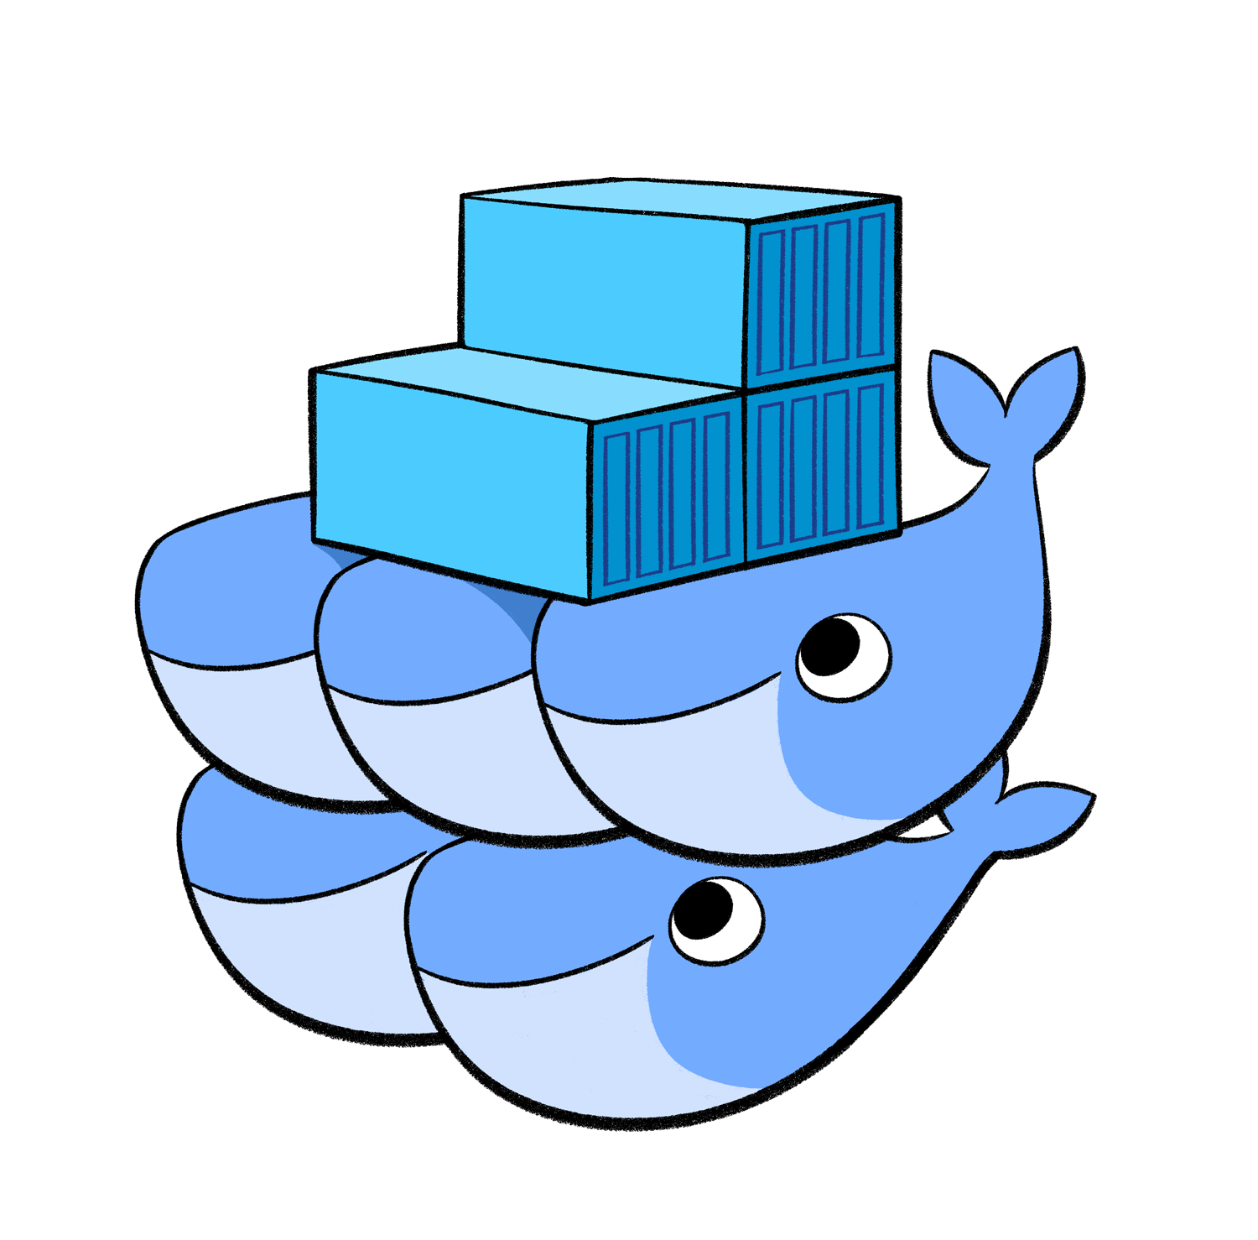
Docker Swarm

Slide 57
Docker Swarm
Docker Swarm is a tool that provides clustering and scheduling facilities to docker containers.
A swarm is a group of machines that are running Docker and joined into a cluster.
Once swarm cluster is created, you continue to run the Docker commands you’re used to, but now they are executed on a cluster by a swarm manager.
The machines in a swarm can be physical or virtual.
After joining a swarm, they are referred to as nodes.

Slide 58
Docker Swarm
When you had to run hundreds of containers, managing them becomes difficult.
If these containers run on separate machines (distributed mode), then their management becomes more difficult.
Thus running them on a cluster makes the management easy.
Following are the advantages of using swarm cluster.

Slide 59
Docker Swarm
Easily perform health Checks on the Containers,
Launching a fixed set of Containers for a particular Docker image.
Scaling the number of Containers up and down depending on the load
Performing rolling update of software across containers

Slide 60
Docker Swarm
Swarm managers can use several strategies to run containers, such as “emptiest node” -- which fills the least utilized machines with containers. Or “global”, which ensures that each machine gets exactly one instance of the specified container.
You instruct the swarm manager to use these strategies in the Compose file.
Swarm managers are the only machines in a swarm that can execute your commands, or authorize other machines to join the swarm as workers.

Slide 61
Docker Swarm
Manager nodes handle cluster management tasks:
maintaining cluster state
scheduling services
serving swarm mode HTTP API endpoints

Slide 62
Docker Swarm
Using a Raft implementation, the managers maintain a consistent internal state of the entire swarm and all the services running on it.
Raft is a consensus algorithm for managing a replicatedlog.
Consensus algorithms allow a collection of machines to work as a coherent group that can survive the failures of some of its members.
Because of this, they play akey role in building reliable large-scale software systems.

Slide 63
Docker Swarm
For testing purposes it is OK to run a swarm with a single manager.
If the manager in a single-manager swarm fails, your services continue to run, but you need to create a new cluster to recover.
To take advantage of swarm mode’s fault-tolerance features, Docker recommends you implement an odd number of nodes according to your organization’s high-availability requirements.
When you have multiple managers you can recover from the failure of a manager node without downtime.

Slide 64
Docker Swarm
A three-manager swarm tolerates a maximum loss of one manager.
A five-manager swarm tolerates a maximum simultaneous loss of two manager nodes.
An N manager cluster tolerates the loss of at most (N-1)/2 managers.
Docker recommends a maximum of seven manager nodes for a swarm.

Slide 65
Docker Swarm
You can create a swarm of one manager node, but you cannot have a worker node without at least one manager node.
By default, all managers are also workers.
Workers are just there to provide capacity and do not have the authority to tell any other machine what it can and cannot do.
To prevent the scheduler from placing tasks on a manager node in a multi-node swarm, set the availability for the manager node to Drain.

Slide 66
Docker Swarm
The scheduler gracefully stops tasks on nodes in Drain mode and schedules the tasks on an Active node.
The scheduler does not assign new tasks to nodes with Drain availability.
You can promote a worker node to be a manager by running docker node promote
You can also demote a manager node to a worker node.

Slide 67
Docker Swarm
Up until now, you have been using Docker in a single-host mode on your local machine.
But Docker also can be switched into swarm mode, and that’s what enables the use of swarms.
Enabling swarm mode instantly makes the current machine a swarm manager.
From then on, Docker runs the commands you execute on the swarm you’re managing, rather than just on the current machine.

Slide 68
Docker Swarm
Create a Swarm Cluster
Requires 2 or more nodes.
First update all the systems
Configure hostname and IP address to each system.
Update hosts file on each node to include IP address and hostname of all other nodes.
Install docker on all nodes
Start the docker service and enable it so that the docker service starts automatically after reboot.

Slide 69
Docker Swarm
Create a Swarm Cluster
For security reasons it is recommended to run docker as a normal user.
Thus create a user and add it to the docker group.
useradd -G docker dockeradm (use any username)
Login as dockeradm
On the node that will work as swarm manager, execute the fwing command.
docker swarm init --advertise-addr <IP of Manager>

Slide 70
Docker Swarm

Slide 71
Docker Swarm
Create a Swarm Cluster
Once the command completes successfully, it will display docker swarm join command with a token number on the screen.
Copy that command in a file and save the file.
Copy this file using scp to other node.
Execute the docker swarm join command on the node that will be worker node.
Now on the manager node execute docker node ls to confirm that work node has joined the cluster.

Slide 72
Docker Swarm

Slide 73
Docker Swarm
The AVAILABILITY column shows whether or not the scheduler can assign tasks to the node:
Active means that the scheduler can assign tasks to the node.
Pause means the scheduler doesn’t assign new tasks to the node, but existing tasks remain running.
Drain means the scheduler doesn’t assign new tasks to the node. The scheduler shuts down any existing tasks and schedules them on an available node.
The MANAGER STATUS column shows node participation in the Raft consensus:

Slide 74
Docker Swarm
No value indicates a worker node that does not participate in swarm management.
Leader means the node is the primary manager node that makes all swarm management and orchestration decisions for the swarm.
Reachable means the node is a manager node participating in the Raft consensus quorum. If the leader node becomes unavailable, the node is eligible for election as the new leader.
Unavailable means the node is a manager that can’t communicate with other managers.

Slide 75
Docker Swarm
If a manager node becomes unavailable, you should either join a new manager node to the swarm or promote a worker node to be a manager.

Slide 76
Docker Swarm
In case if you miss the join command displayed during docker swarm init command, you can use following command and get the token.

Slide 77
Docker Swarm

Slide 78
Docker Swarm
Create a service on Swarm
docker service create --replicas 2 -p 80:80 --name app1 nginx

Slide 79
Docker Swarm
The docker service ps service-name command provides details abou the containers create for the service.
Thus the docker se ps app1 will provide details about the service that is just created

Slide 80
Docker Swarm
The docker ps command on both nodes shows the container for the app1 service created.

Slide 81
Docker Swarm
On Manager machine if you open browser and access node1 and node2, you get the nginx default website.

Slide 82
Docker Swarm
On the manager machine you can run the command docker node ps node-name to get the status of each node.

Slide 83
Docker Stack
Docker Stack is a command line tool that allows you to deploy a service on the docker swarm cluster with just one command.
It makes use of similar docker compose yaml file but with some difference.
Docker stack command is built in the docker CLI.
Docker stack also allows you the service with one command.

Slide 84
Docker Stack - Sample yaml file
web-app-compose.yaml file contents

Slide 85
Docker Stack deploy

Slide 86


